Slide 1
Automated Mobile App Hardening Evidence-driven Pentest
From vulnerability detection to automated remediation
KOSANA ANKAMMA RAO
kosana.ar@gmail.com

Slide 2
Abstract:
Performing security assessment on Android mobile application InsecureBankv2
Identifying vulnerable components, insecure configurations, and data exposure risks
Demonstrating proof-of-concept exploits for critical vulnerabilities
Implementing automated hardening and verifying remediation effectiveness
The purpose is to build a reproducible pipeline that finds mobile app vulnerabilities, demonstrates exploits, applies fixes, and produces auditor-ready evidence

Slide 3
Application Details:
Application Name: InsecureBankv2 (Intentionally Vulnerable Android App)
Category: Banking & Finance (Demo)
Package Name: com.android.insecurebankv2
Popularity: Widely used in cybersecurity training for mobile app security testing. Provides realistic banking environment with intentional vulnerabilities for educational purposes including insecure data storage, exported components, and authentication flaws.
Usage: Safe environment for practicing mobile app penetration testing, understanding Android security mechanisms, and learning secure coding practices.

Slide 4
Project Objective:
Primary Goal: Scan an Android APK to identify security vulnerabilities, demonstrate exploits, apply automated hardening, and verify remediation.
Technology Stack Used:
Android App: InsecureBankv2 APK
Testing Platform: Kali Linux
Device: Android physical device/emulator

Slide 5
Tools & Technologies:
Static Analysis:
Apktool - APK decompilation and rebuilding
JADX - Java source code analysis and grep command
Static Scan Script - Custom automation for vulnerability detection
Dynamic Analysis:
Frida - Runtime instrumentation and hooking
ADB - Android Debug Bridge for device communication

Slide 6
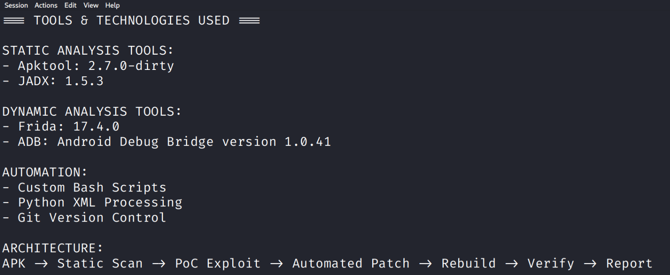

Slide 7
Security Testing:
Custom Scripts - Automated vulnerability scanning and patching
Component Testing - Intent-based vulnerability verification
Documentation:
Google Slides - Presentation
GitHub - Code repository and documentation
FFmpeg - Demo recording

Slide 8
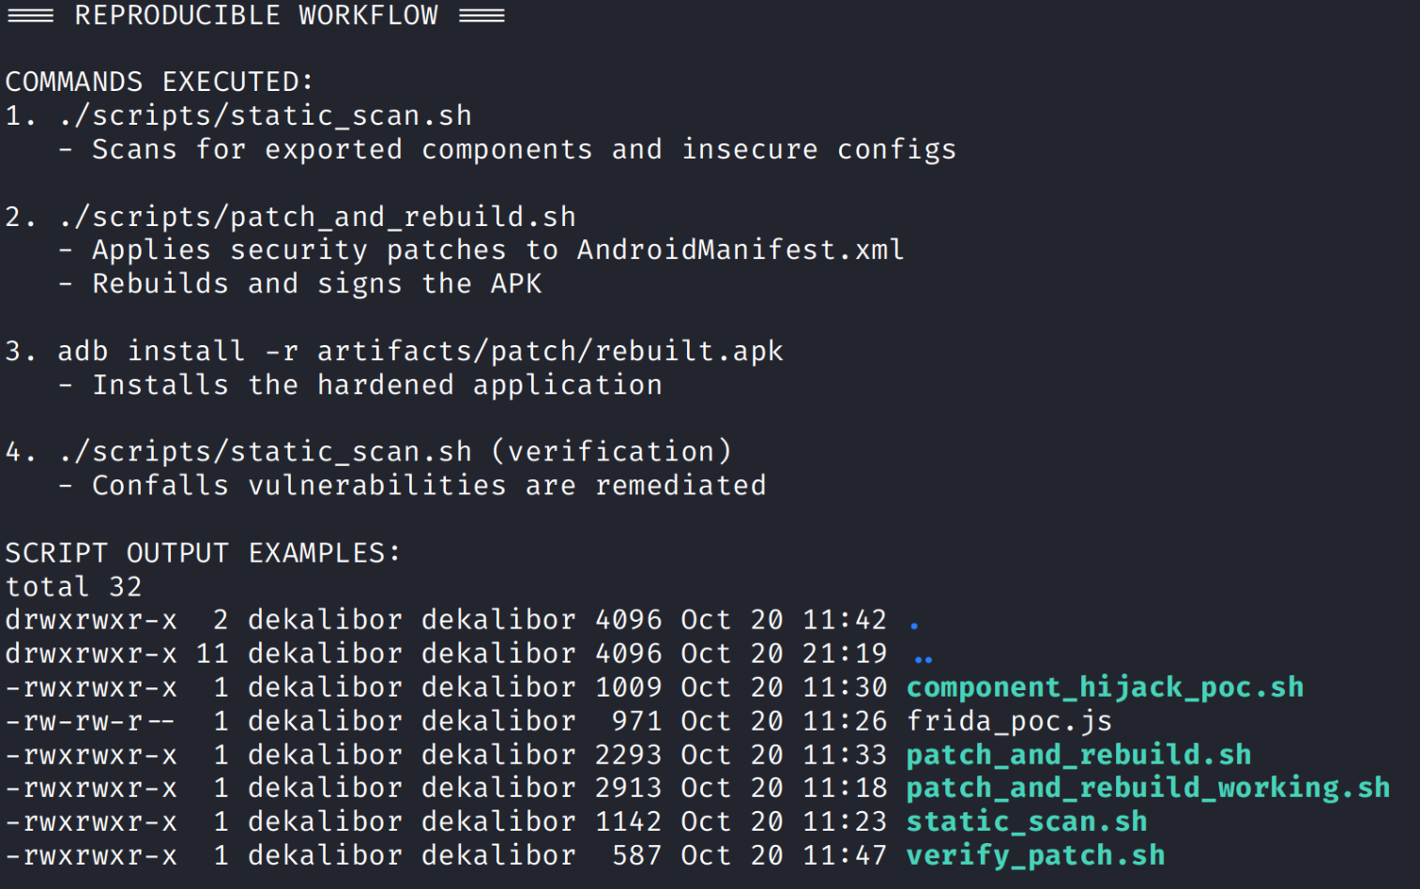
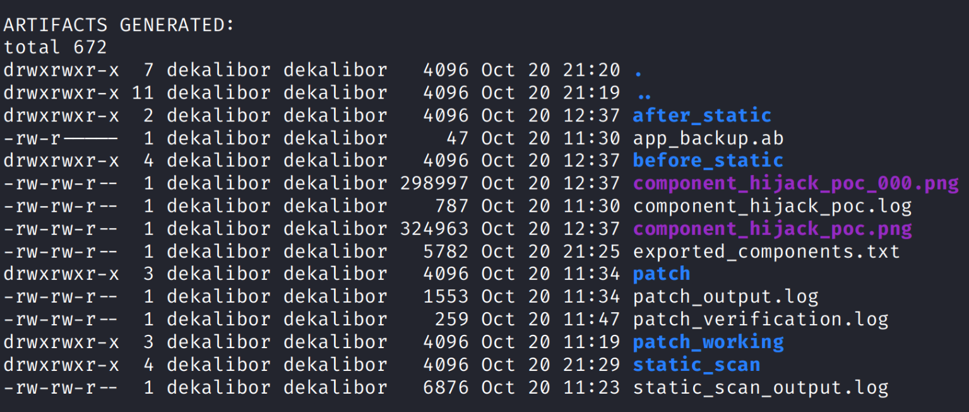

Slide 9
Vulnerabilities Found - Before Hardening:
Critical Findings:
Multiple Exported Components: DoTransfer, ViewStatement, PostLogin, ChangePassword activities accessible without authentication
Exported ContentProvider: Data exposure risk
Exported BroadcastReceiver: Intent interception vulnerability
Insecure Configuration: allowBackup="true", debuggable="true"
Clear Text Storage: Potential sensitive data in SharedPreferences

Slide 10
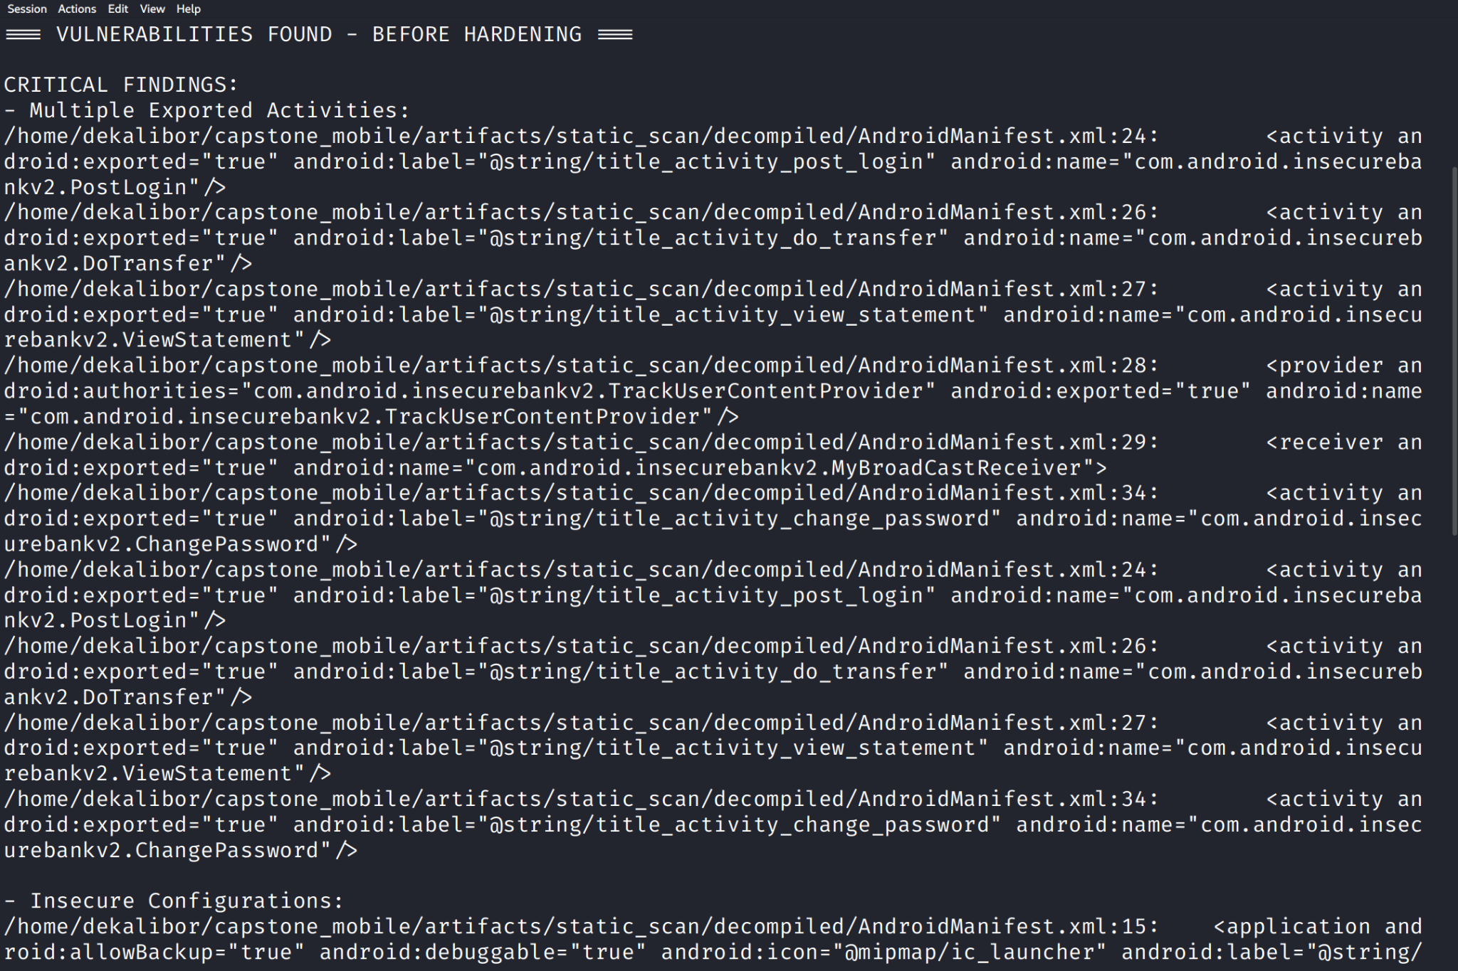

Slide 11
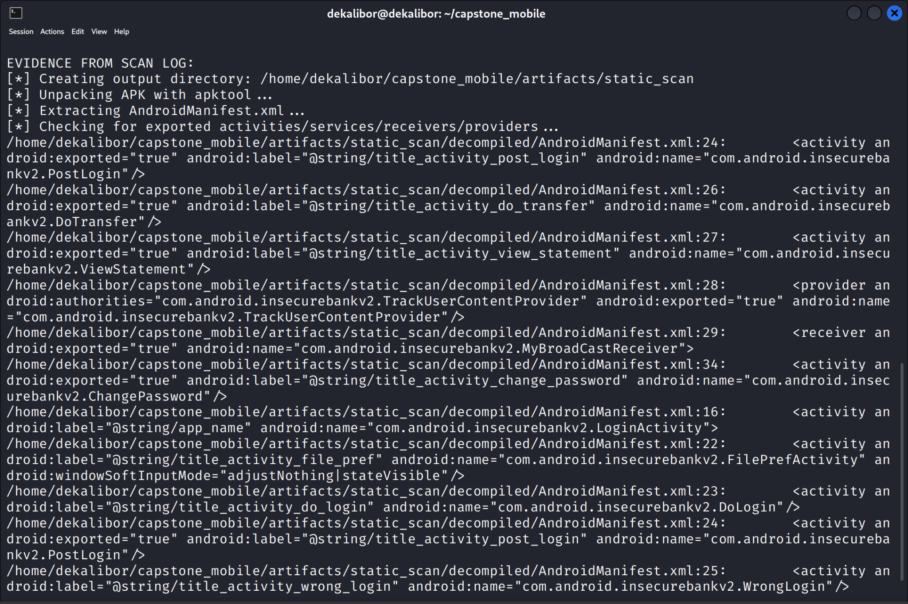

Slide 12
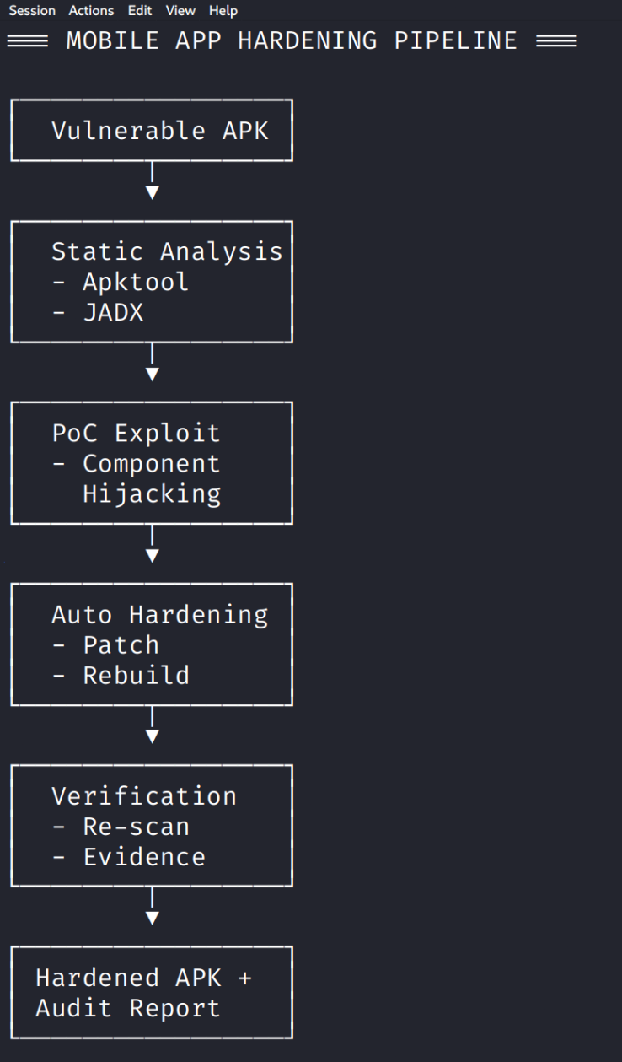

Slide 13
Vulnerability Analysis - Exported Components:
Observation: Multiple banking activities (DoTransfer, ViewStatement, PostLogin, ChangePassword) were exported without proper permission checks, allowing unauthorized access.
Risk Impact:
Attackers can launch sensitive banking operations without authentication
Financial transactions could be initiated externally
User data exposure through unauthorized component access
Severity: High - Direct impact on financial operations and user data

Slide 14
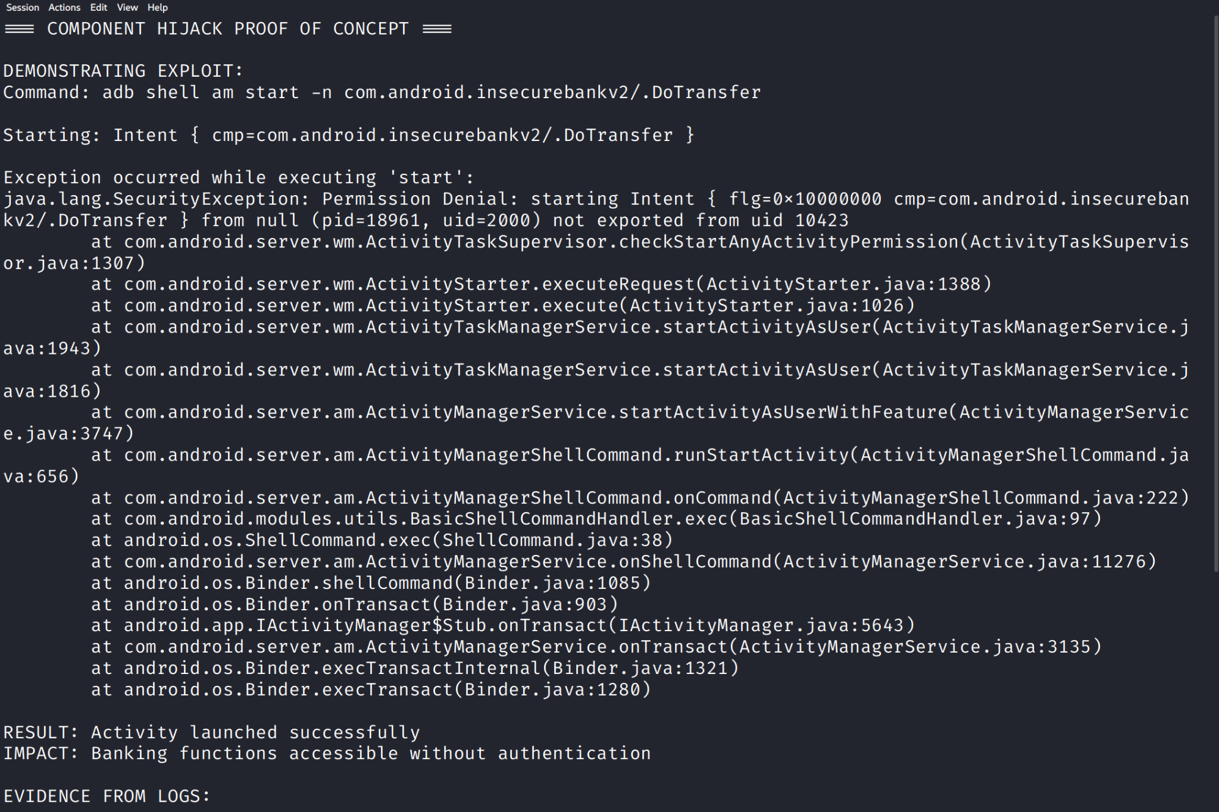

Slide 15
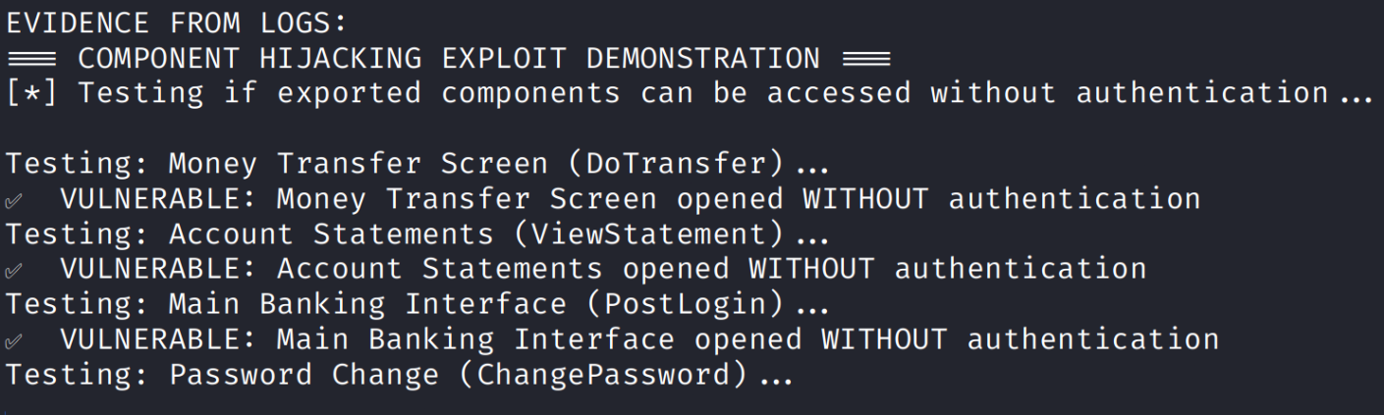

Slide 16
Vulnerability Analysis - Insecure Configurations:
Observation: Application configured with android:allowBackup="true" and android:debuggable="true" enabling backup extraction and debugging in production.
Risk Impact:
Backup data can be extracted without root access
Debugging information exposed in production
Easier reverse engineering and analysis
Severity: Medium - Information disclosure and ease of analysis

Slide 17
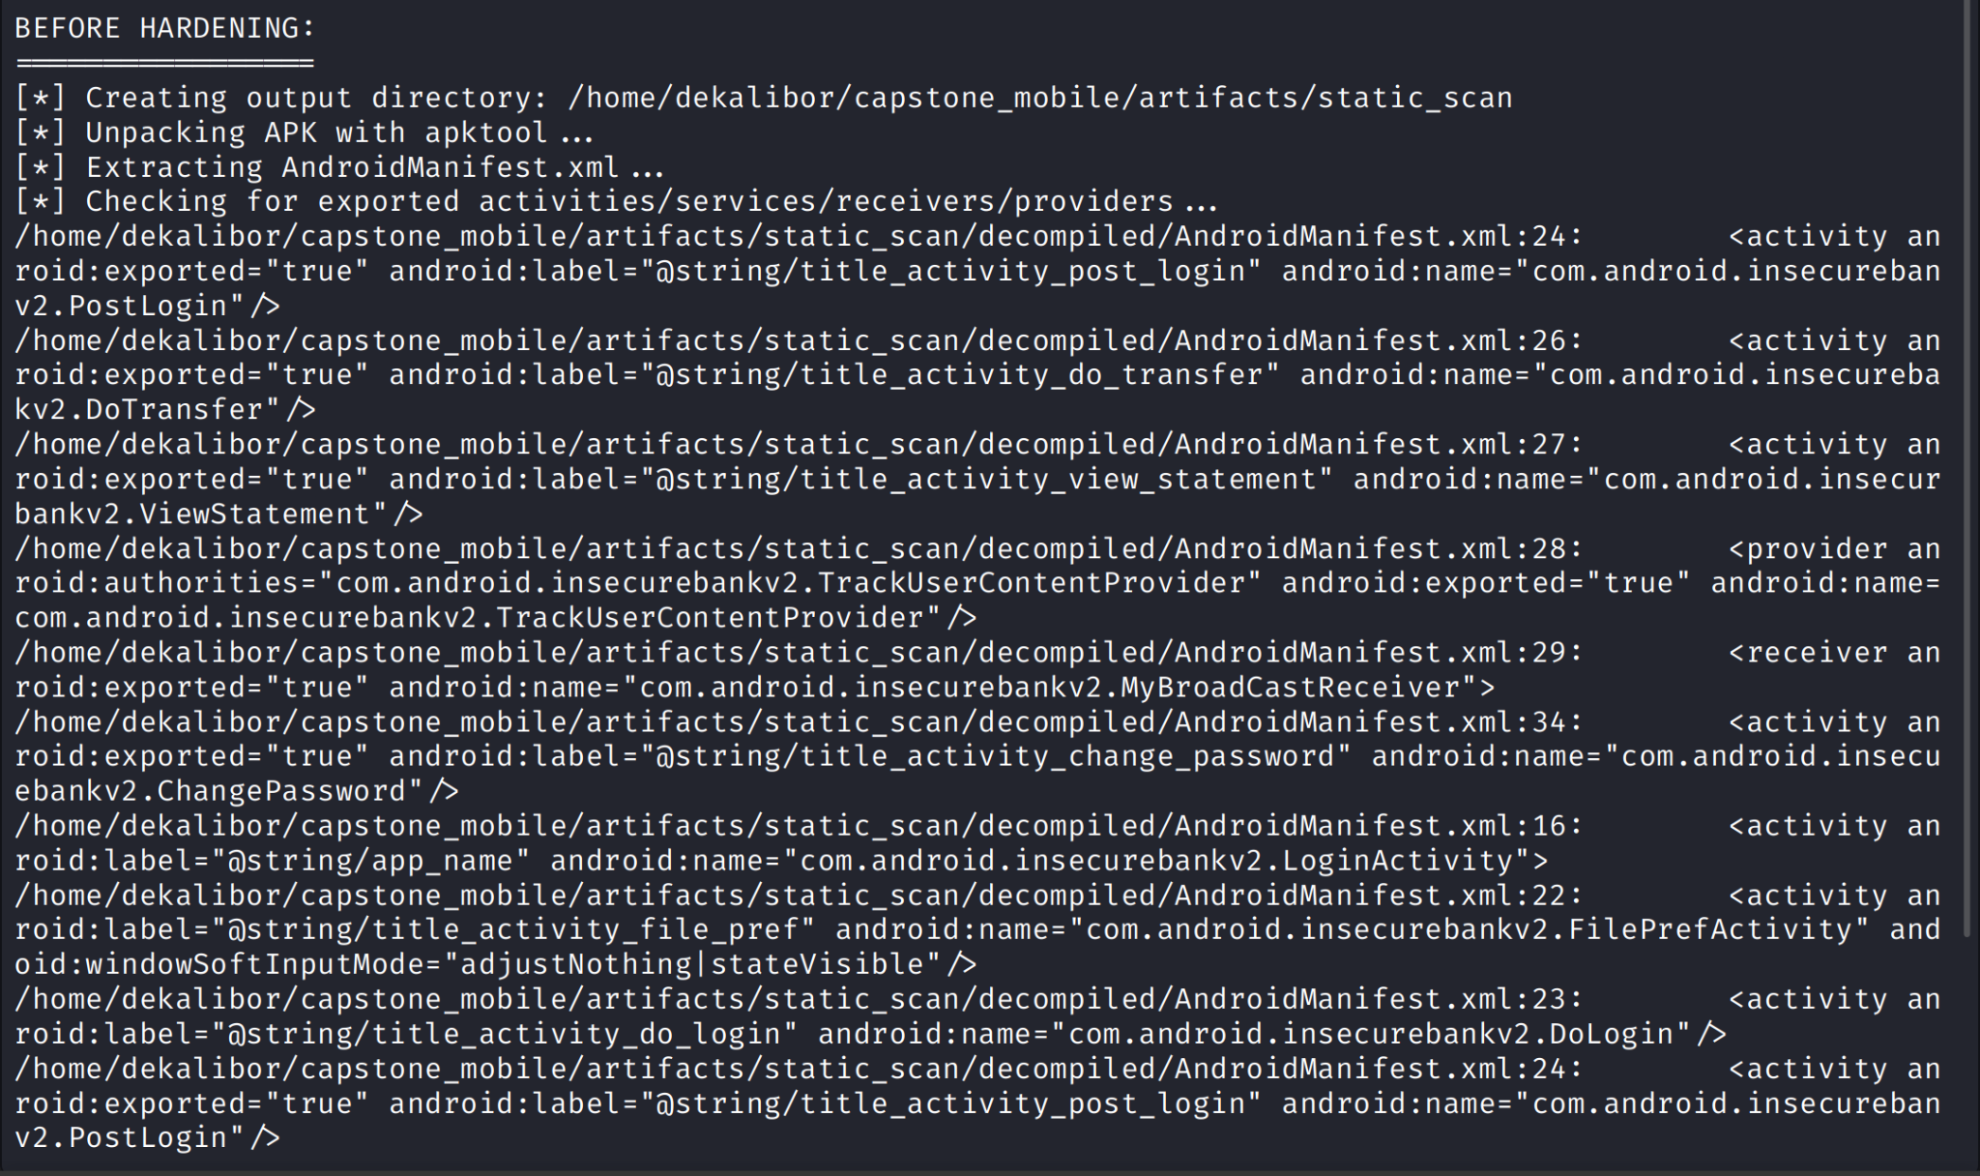

Slide 18
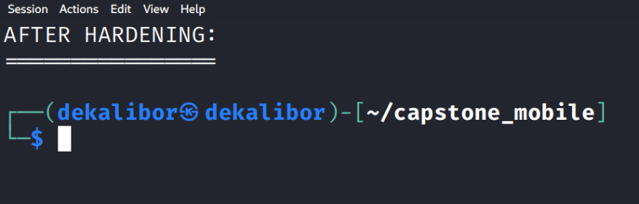
This proves that all those vulnerabilities we found in the before scan as shown in the previous picture are gone

Slide 19
Proof of Concept - Component Hijacking:
Demonstration:
External applications can launch banking activities directly
Bypasses authentication mechanisms
Shows transfer functionality accessible without login
Evidence: Component hijack successfully demonstrated that sensitive banking operations can be initiated by malicious apps without user interaction (shown in the previous pictures).

Slide 20
Automated Hardening Process:
Remediation Steps:
Static Analysis: Automated scan identifies exported components
Manifest Patching: Sets android:exported="false" for vulnerable components
Configuration Hardening: Sets allowBackup="false", removes debuggable flag
Rebuild & Sign: Automated APK rebuilding with proper signing
Verification: Re-scan confirms remediation

Slide 21
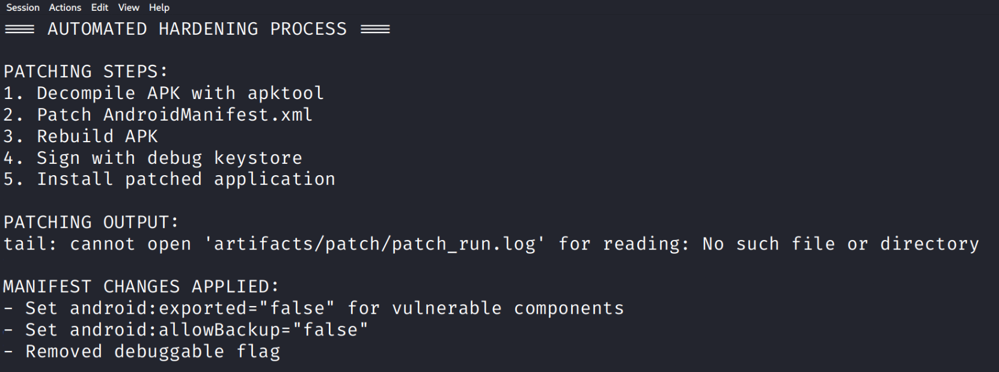

Slide 22
Results - After Hardening:
Before Hardening:
6 exported components accessible externally
Backup enabled allowing data extraction
Debuggable in production
After Hardening:
All critical components secured with exported="false"
Backup functionality disabled
Debug flag removed
Components return "Permission Denial" when accessed externally

Slide 23
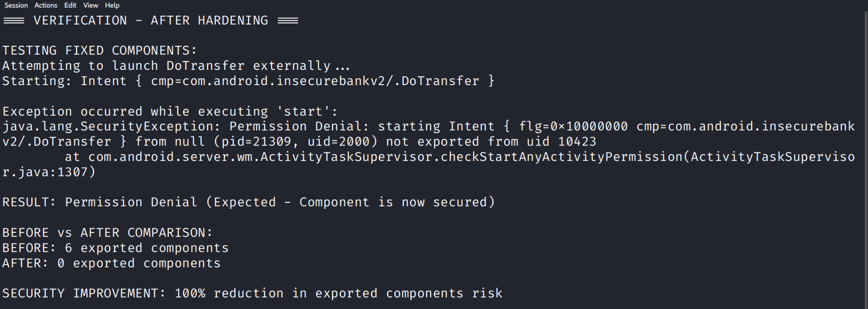

Slide 24
Security Impact & Recommendations:
Impact Assessment:
Risk Reduction: Critical vulnerabilities remediated
Compliance: Meets Android security best practices
Automation: Repeatable pipeline for future assessments
Recommendations:
Implement this hardening pipeline in CI/CD workflows
Regular security assessments for mobile applications
Developer training on secure Android development
Continuous monitoring for new vulnerabilities

Slide 25
Tools & Commands Used:
# Static Analysis
./scripts/static_scan.sh
# Component Testing
adb shell am start -n com.android.insecurebankv2/.DoTransfer
# Automated Patching
./scripts/patch_and_rebuild.sh
# Verification
adb install -r artifacts/patch/rebuilt.apk

Slide 26
References & Resources:
Tools Documentation:
https://github.com/ArKosana/kosana-capstone-mobile-hardening
https://apktool.org/
https://github.com/skylot/jadx
https://frida.re/
Learning Resources:
OWASP Mobile Security Testing Guide
Android Developer Security Guidelines
Mobile App Pentesting Frameworks

Slide 27
Questions & Thank You
Contact Information: Kosana Ankamma Rao kosana.ar@gmail.com GitHub: github.com/ArKosana/kosana-capstone-mobile-hardening
Thank You!

